Slide 1
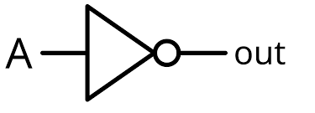
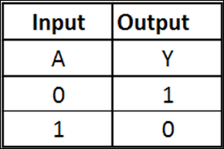

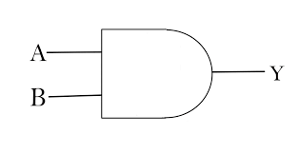
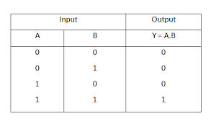
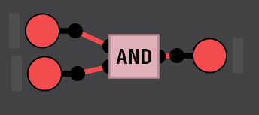
Tittle:
Introduction to Digital Logic Simulator
Objective:
To learn how to use Digital Logic sim
To learn how to create all types of gates using AND gates & NOT gates
Theory:
1)NOT gates
A type of in which if input is high output will low(inverse).
Symbol: Truth Table: In DL Sim:
2)AND gate
A type of logic gate in which the output is high only if all of the
input are high and, its Boolean expression is Y=A.B
Symbol: Truth Table:
In DL Sim:

Slide 2
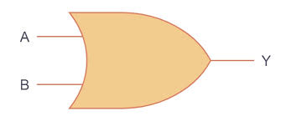
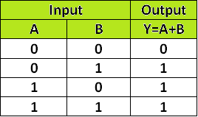
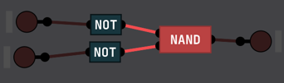
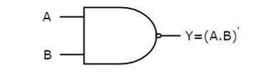
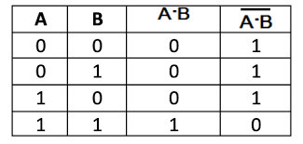

3)OR Gate
A type of logic gate in which the output is high if at least one of the inputs is high and, its Boolean expression is Y=A+B
Symbol: Truth Table:
In DL Sim:
4)NAND Gate A type of logic gate in which the output is high unless all of the inputs are high and, its Boolean expression is Y=(A.B)’
Symbol: Truth Table:
In DL Sim:
5) NOR Gate A type of logic gate in which the output is high only if all of the inputs are low and, its Boolean expression is Y=(A+B)’

Slide 3
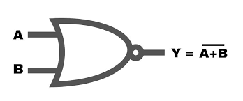
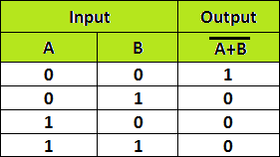
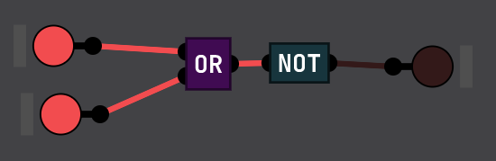
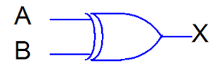
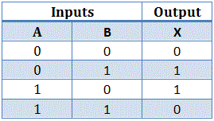
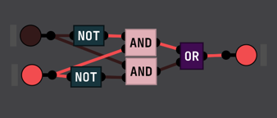
Symbol: Truth Table:
In DL Sim:
6) XOR Gate (Exclusive OR)
A type of logic gate in which the output is high only if exactly one of the input is high and, its Boolean expression is Y=BA’+AB’
Symbol: Truth Table:
In DL Sim:

Slide 4
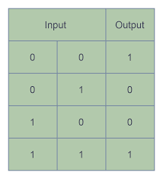
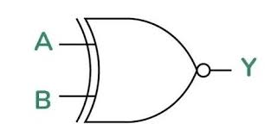
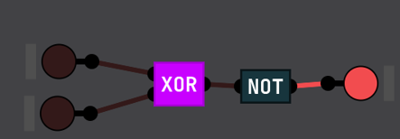
7) XNOR Gate
The XNOR (Exclusive NOR) gate is the inverse of XOR,
meaning it outputs HIGH (1) when both inputs are the same.
and, its Boolean expression is Y=AB+A’B’
Symbol: Truth Table:
In DL Sim:
8)Half Adder
A half adder is a basic combinational circuit used for binary addition. It takes two input bits and produces a sum and a carry.
Boolean Expressions
Sum (S) = A ⊕ B → Uses an XOR gate
Carry (C) = A.B → Uses an AND gate

Slide 5
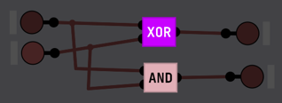
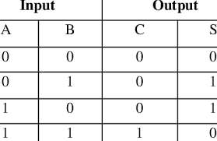
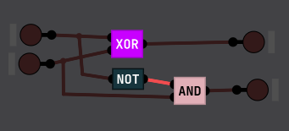
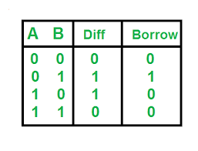
In DL Sim:
Truth Table:
8)Half Subtractor
A half subtractor is a combinational circuit that performs binary subtraction for two input bits. It produces a difference and a borrow output
Boolean Expressions
Difference (D) = A ⊕ B → Uses an XOR gate
Borrow (B) = A' . B → Uses an AND gate with A inverted
In DL Sim: Truth Table:

Slide 6
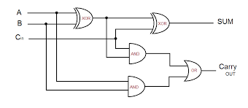
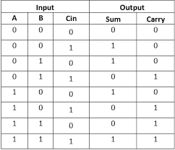
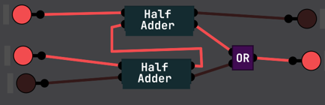
9)Full Adder
A full adder is a combinational circuit that performs binary addition of three input bits—two operand bits and a carry input.
Boolean Expressions
Sum (S) = A ⊕ B ⊕ Cin → Uses XOR gates
Carry (Cout) = (A.B) + (A ⊕ B).Cin → Uses AND & OR gates
Diagram: Truth Table:
In DL Sim:
10)Full Subtractor
A full subtractor is a combinational circuit that performs binary subtraction of three input bits—two operand bits and a borrow input (Bin). It computes both the difference and the borrow output.
Boolean Expressions
Difference (D) = A ⊕ B ⊕ Bin → Uses XOR gates
Borrow (Bout) = (A'.B) + (A’. Bin) + (B . Bin) → Uses AND & OR gates

Slide 7
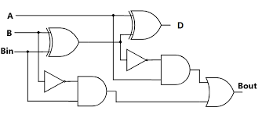
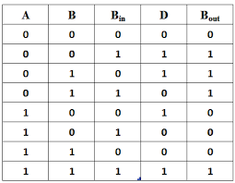
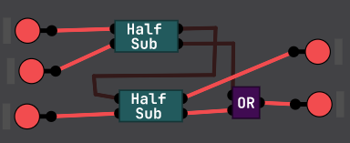
Diagram: Truth Table
In DL Sim :
Conclusion:
In the lab, we found the fundamental rules of Digital Logic starting with a simple logic gate such as AND, OR, and NOT. We also learned universal gates such as NAND and NOR that are used to create any other type of logic gate. We also practiced designing many types of gates using only AND & NOT gates in the Sim program for Digital Logic. Through interactive exercises, we understood better how logic Gates function and how they are combined to form more complex circuits

